Slide 1
Go Green (ICG PS)
by TheOdd1s_out

Slide 2
Disregard of Nature by Humans
Humans are aiming for increased productivity in each sector.
As a result, there is a disregard for nature and a sole focus on how to extract resources and then effectively utilize them.
Companies are hiding from their responsibility towards society.
There are marginalized communities which are adversely affected by the drastic climate changes.
But they are less/not recognized because the focus is rather on the large firms.
On the bright side, we are slowly realizing the direction we are headed towards and correcting it.
There is hence a need for an open-ended and sustainable framework.

Slide 3
Stakeholders in this Topic
Local communities, marginalized societies, indigenous people etc.
Non-Governmental Organisations (NGOs).
Customers / Consumers.
Employees (of companies) and Labour Unions.
Shareholders and Investors (including VCs).
Governments and Regulatory Bodies.
Academic and Research Institutions.
Media and Journalists.
Future Generations ! [Surprisingly, future generations will also be impacted by the steps we take towards destroying / preserving our environment]

Slide 4
Objectives of Framework
Evaluate the environmental impact of human industrial activities and pursuits.
Assess social responsibility efforts of organizations.
Evaluate governance practices.
Propose actionable measures to foster sustainable growth and profitability.
Explore innovative approaches and solutions to address sustainability challenges.
Brainstorm
solutions
Propose Actions
Analyze results
Assess efforts
Evaluate situation

Slide 5
Broad View of Framework
Components:
Data Collection.
Data Analysis.
Key Performance Indicators (KPIs).
Assessment and Scoring.
Actionable Measures and Recommendations:
Insights Generation.
Recommendations.
Innovation and Collaboration:
Innovative Approaches.
Collaboration.
Integration and Implementation:
Integration with Existing Systems.
Implementation Support.
Monitoring and Continuous Improvement:
Monitoring.
Continuous Improvement.

Slide 6

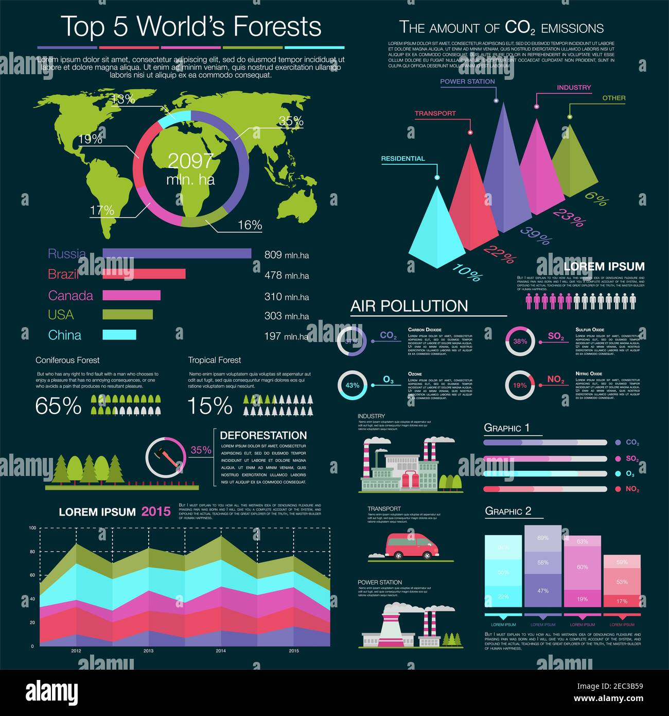

Slide 7
Mechanism of Framework
Framework Components:
Data Collection: It involves collecting relevant data from various sources, including environmental impact assessments, social responsibility reports, governance metrics etc.
Data Analysis: The collected data is analyzed using advanced data analysis techniques, such as machine learning algorithms and predictive modeling. This analysis helps in understanding patterns, identifying trends, and evaluating the performance of organizations in terms of environmental impact & social responsibility
Key Performance Indicators (KPIs): The framework defines a set of KPIs specific to each aspect of sustainability - environmental impact, social responsibility, and governance. These KPIs serve as measurable metrics against which the performance of organizations is assessed.
Assessment and Scoring: Based on the data analysis and KPIs, organizations are evaluated and assigned scores or ratings in each sustainability aspect. The assessment provides a comprehensive picture of the organization's sustainability performance and areas for improvement.

Slide 8
2. Actionable Measures and Recommendations:
Insights Generation: The framework generates insights and identifies areas of strength and weaknesses for organizations based on the assessment results.
Recommendations: The framework provides actionable recommendations and measures to improve sustainability performance. They may include changes in processes, resource optimization, adoption of sustainable technologies, employee engagement, community outreach, and other relevant strategies.
3. Innovation and Collaboration:
Innovative Approaches: It encourages the exploration of innovative approaches and solutions to address sustainability challenges. It promotes creativity, research, and the adoption of emerging technologies that can drive sustainable development and offer competitive advantages.
Collaboration: It emphasizes the importance of collaboration among different stakeholders, including organizations, academia, NGOs, and government bodies. Collaboration helps in sharing knowledge, best practices, and resources, as well as fostering collective action towards sustainable goals.

Slide 9
4. Integration and Implementation:
Integration with Existing Systems: The framework can be integrated with existing systems, such as sustainability management software, enterprise resource planning (ERP) systems, and reporting platforms. This integration ensures seamless data flow and avoids duplication of efforts.
Implementation Support: To facilitate the implementation of recommended measures, the framework can provide implementation guidelines, training programs, and support resources. These resources assist organizations in translating recommendations into actionable plans and embedding sustainability practices into their daily operations.
5. Monitoring and Continuous Improvement:
Monitoring: Regular monitoring helps organizations measure their progress, identify emerging issues, and make informed decisions to enhance their sustainability practices.
Continuous Improvement: The framework promotes a culture of continuous improvement by encouraging organizations to learn from their experiences, adapt strategies, and refine practices over and over.

Slide 10
Thank You !!

